Slide 1
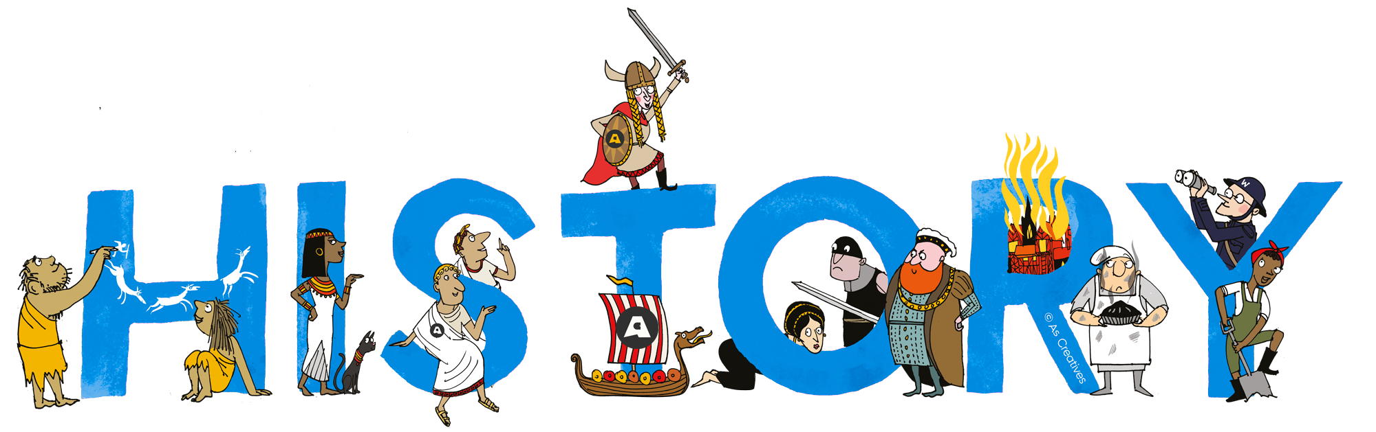

OF OPERATING SYSTEM
Yufis Azhar
Sistem Operasi – Informatika – UMM

Slide 2
The Evolution of Operating System
Open Shop
Batch Processing
Multiprogramming
Timesharing
Concurrent Programming
Personal Computing
Distributed Systems
Sistem Operasi – Informatika – UMM

Slide 3
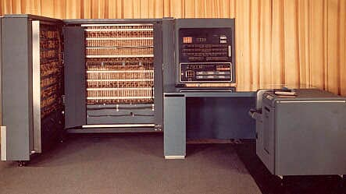
1. Open Shop
We begin the story of operating systems in 1954 when computers had no operating systems but were operated manually by their users
Each user was allocated a minimum 15-minute slot, of which time he usually spent 10 minutes in setting up the equipment to do his computation
By the time he got his calculation going, he may have had only 5 minutes or less of actual computation completed—wasting two thirds of his time slot
IBM 701 (1954)
Sistem Operasi – Informatika – UMM

Slide 4
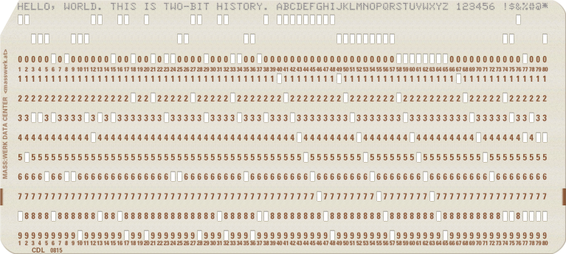
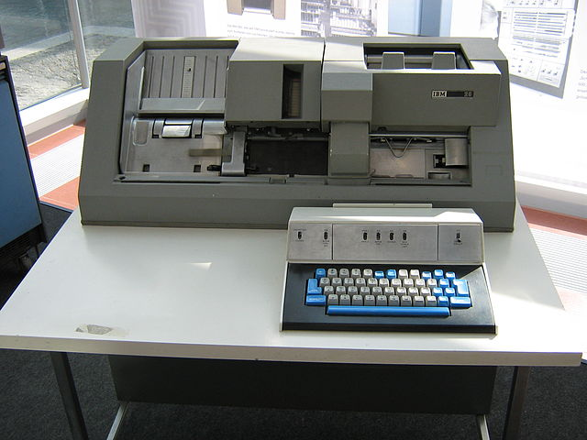
2. Batch Processing
The IBM 029 Punch Card
The IBM 029 Punch Card Maker and Reader (1959)
The early operating systems took drastic measures to reduce idle computer time: the users were simply removed from the computer room! They were now asked to prepare their programs and data on punched cards and submit them to a computing center for execution. The open shop had become a closed shop
Operators collected decks of punched cards from users and used a satellite computer to input a batch of jobs from punched cards to a magnetic tape. This tape was then mounted on a tape station connected to a main computer. The jobs were now input and run one at a time in their order of appearance on the tape. The running jobs output data on another tape. Finally, the output tape was moved to a satellite computer and printed on a line printer. While the main computer executed a batch of jobs, the satellite computers simultaneously printed a previous output tape and produced the next input tape
Sistem Operasi – Informatika – UMM

Slide 5
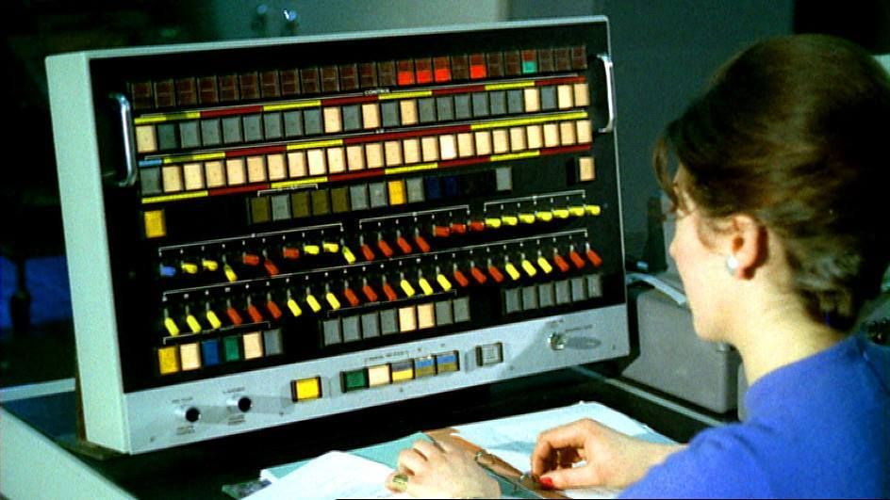
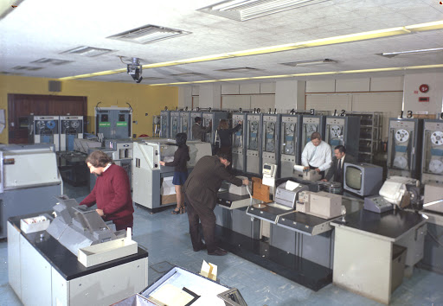
3. Multiprogramming
In the 1960s large core memories, secondary storage with random access, data channels, and hardware interrupts changed operating systems radically. Interrupts enabled a processor to simulate concurrent execution of multiple programs and control simultaneous input/output operations. This form of concurrency became known as multiprogramming
Multiprogramming and secondary storage made it possible to build operating systems that handled a continuous stream of input, computation, and output on a single computer using drums (or disks) to hold large buffers. This arrangement was called spooling.
Atlas Computer (1962)
Sistem Operasi – Informatika – UMM

Slide 6
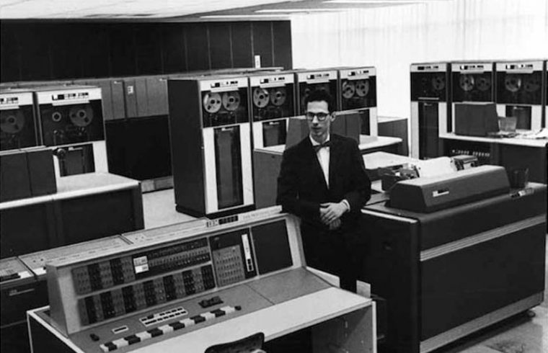

4. Time Sharing
John McCarthy proposed the original idea of timesharing at MIT
Compatible Time-Sharing System (CTSS)
Sistem Operasi – Informatika – UMM

Slide 7
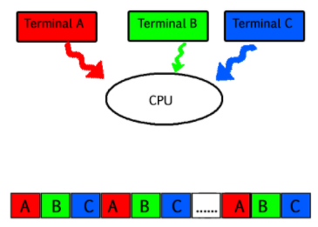
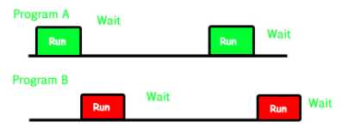
Multiprogramming VS Multitasking
Multitasking is a logical extension of multiprogramming
Multiprogramming works solely on the concept of context switching
Multitasking is based on time sharing alongside the concept of context switching.
Multitasking
Multiprogramming
Sistem Operasi – Informatika – UMM

Slide 8
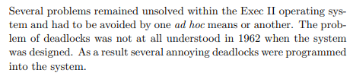
5. Concurrent Programming
From the mid-1960s to the mid-1970s computer scientists developed a conceptual basis that would make operating systems more understandable. This pioneering effort led to the discovery of fundamental principles of concurrent programming. The power of these ideas was demonstrated in a handful of influential model operating systems.
Sistem Operasi – Informatika – UMM

Slide 9
6. Personal Computing
In the 1970s microprocessors and semiconductor memories made it feasible to build powerful personal computers. Reduced hardware cost eventually allowed people to own such computers
Sistem Operasi – Informatika – UMM

Slide 10
7. Distributed System
By 1980 the major concepts of operating systems had already been discovered
Many distributed systems were built on top of the old time-sharing system Unix, which was designed for central rather than distributed computing (Pike 1995)
In most distributed systems, process communication was based on a complicated, unreliable programming technique, known as remote procedure calls.
Only a handful of distributed systems, including Locus (Popek 1981) and the Apollo Domain (Leach 1983), were developed into commercial products.
Sistem Operasi – Informatika – UMM

